Slide 1

BABY NAMES PROJECT
Emily Boling/phil lee/mark souverville

Slide 2
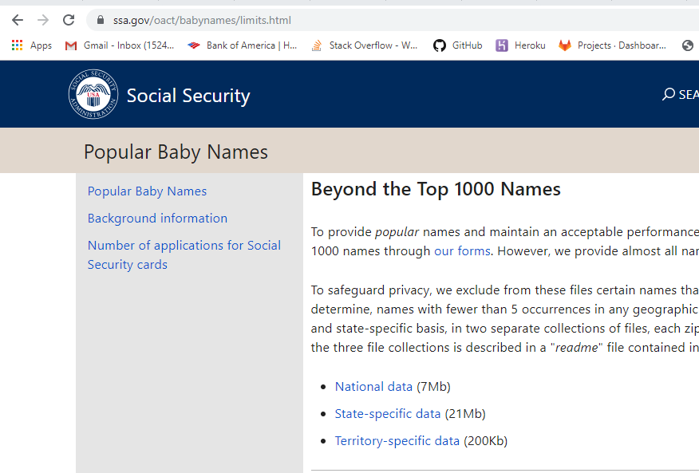
FINDING THE DATA
www.ssa.gov
6,028,201 lines of data before cleaning
State-specific data used (21kb)
Notes:
Talk about why interested, how people decide to name their kids a certain way

Slide 3
Cleaning the data
txtcollector to zip all files together
Removing the empty space between states
Adding headers
Inserted first letter of name (name initial)
Inserted a region and decades

Slide 4
Questions to answer
What are the most popular baby names from the past 100 years
Are some letters more popular for names
How much has the population fluctuated in the past 100 years: what decades have the largest influx
Are some names more popular in certain regions of the US
Are there more unique female or male names
What are the top names from each decade

Slide 5
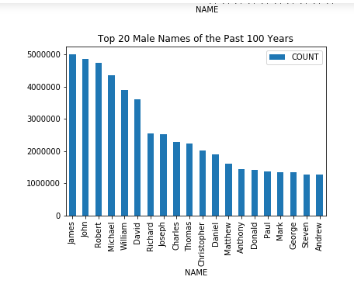
Most popular male names from past 100 years
James
John
Robert
Michael
David

Slide 6
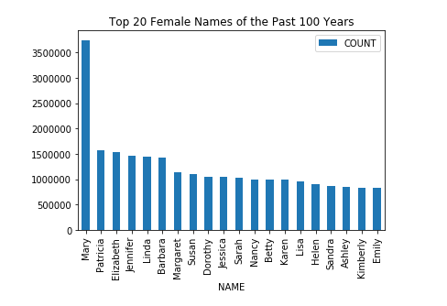
Most popular female names from past 100 years
Mary
Patricia
Elizabeth
Jennifer
Linda

Slide 7
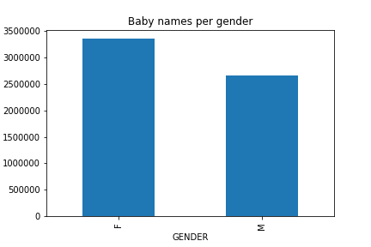
More unique female names historically
There are more female names used in the past 100 years, there is more of a variety of female names being assigned to children born in the past 100 years

Slide 8
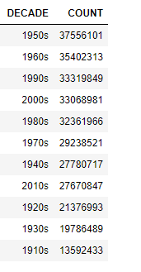
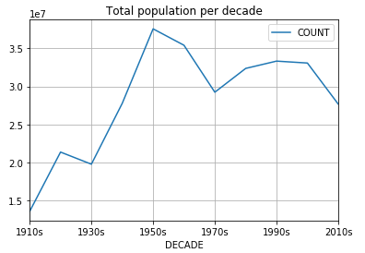
Which decades had the largest influx of babies?

Slide 9
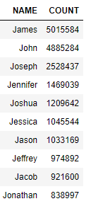
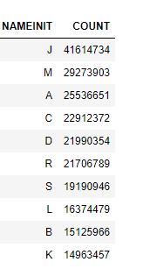
Are some letters more popular than others

Slide 10
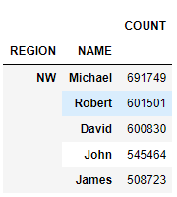
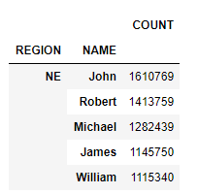
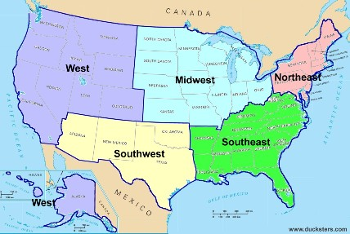
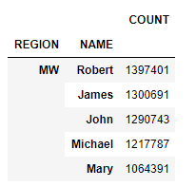
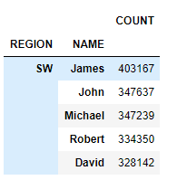
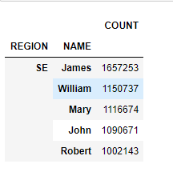

Slide 11
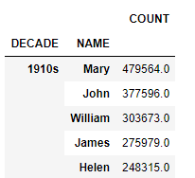
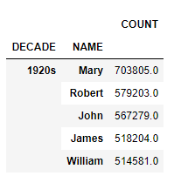
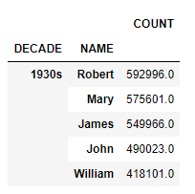
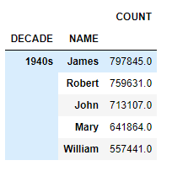
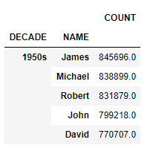
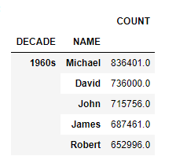
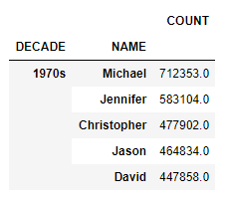
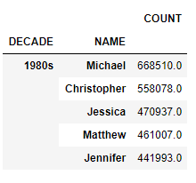
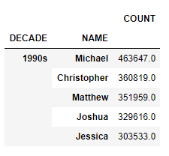
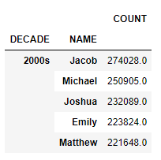
What are the most popular names of each decade

Slide 12
conclusions
Most popular names have not significantly changed in 100 years
There is a greater variety of female names than male names
Births peaked in 1957 and is currently trending downwards
Large data sets are difficult to work with sometimes
Learned a lot by slicing data and applying skills from class
Create Main Data Frame, then Filter, the Group

